Slide 1

ParkinsonPal
Your friendly IoT companion who will help you with the coexistence of the disease.
Participants: Luca Barotto, Marta Bono, Francesco Calice, Candela Muzás

Slide 2
What is ParkinsonPal?
ParkinsonPal is an innovative system that aims to improve the quality of life of patients affected with Parkinson’s Disease.
Retrieve data
Analyze data
Statistical evaluation
Deal with symptoms or emergencies

Slide 3
How ParkisonPal is useful?
Why is it important to create solutions for patients with Parkinson’s Disease? It is important to analyze the impact of this disease on the society, in term of costs, incidence and progression.
2° most common neurodegenerative disease
Incidence: 12/100’00
1.1 to 1.3 billions of euros paid by the italian NHS yearly
Annual cost of one patient, paid by NHS and the society: 13000-22000 euros
Disease progression not constant
This is due to many factors, such as:
Age of onset: >60 (for 70% of the cases)
10% of cases with age between 20-50 years old.
Both the percentage of young and elderly cases is expected to increase
Annual cost of treatment, to be paid by the patient: 1500-2700 euros
Natural progression of the disease.
Response to therapy no longer effective.
Without a continuous monitoring, it is not possible to slow the progression the disease.

Slide 4




Retrieve data
The data are retrieved by three mandatory sensors, positioned on the body of the patient. There is also the possibility to add other devices, if wanted.
Tremor of the patient’s wrist, by their smartwatch.
Stride of the patient, by their sensorized belt.
Pressure of the patient, by a sensorized insole.
Other desired devices.

Slide 5
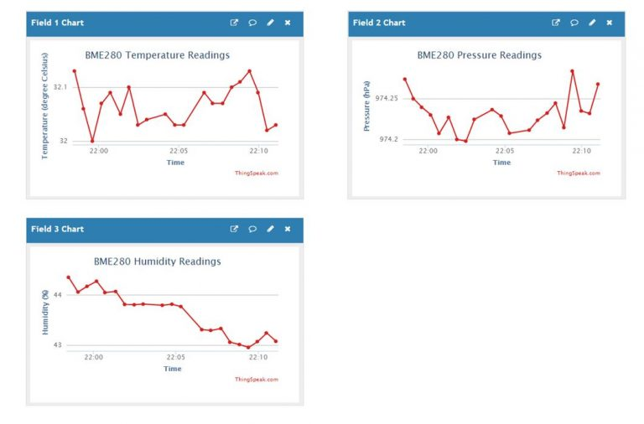
Analysis of data and statistical evaluation
For each measure, on the application ThingSpeak are available 6 graphs that represents the trend over time of the measures and when the episodes occurs.
It is also possible to retrieve this statistical information via Telegram dedicated channel.

Slide 6
Adverse events
Tremor
Definition: Uncontrolled tremor all over the patient’s body.
Possible consequences: fall, self harm.
Prevented by: Activation of the device «Deep Brain Stimulation» or by the injector of medicine L-DOPA.
Freezing
Definition: Sudden inability to move, take a step, turn around, or cross narrow spaces like a door.
Possible consequences: fall.
Prevented by: Emission of a rhythmic sound from the smartwatch.

Slide 7



Emergency events
Fall
Possible consequences: broken bones, incapabilty to rise, head trauma, fainting …
Emergency response: Warning of falling to emergency contacts via Telegram Bot.

Slide 8
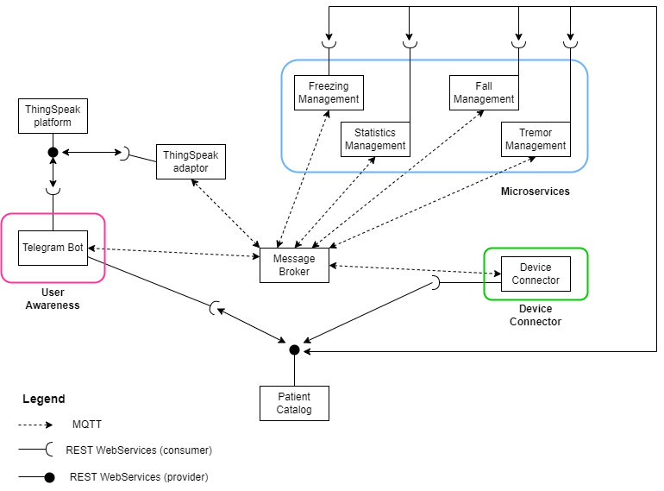
System analysis

Slide 9
Use case analysis
Our system is composed by four main actors:
Device connector, responsible for the management of the device for each patients;
Patient catalog, responsible for the management and communication of the whole system;
Microservices, responsible for analysing sensor data and activating actuator devices;
User Awarness, responsible for the communication between the patient and the system.

Slide 10
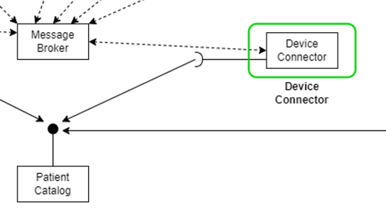
Device Connector

Slide 11

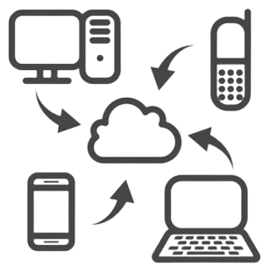


Device Connector
Device Connector
The Device Connector is responsible for the following tasks:
Registering the new patient to the catalog.
Simulate data from each patient’s sensors.
Simulate the activation on the patient’s actuators.
Publish the data under the correct topic via MQTT protocol.

Slide 12
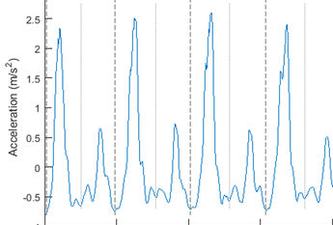
Device Connector
Simulated measurements
Time from last peak
Time from last peak (TimeLastPeak)
Sensor: Waist accelerometer from sensorized belt
Definition: TimeLastPeak (s) is the range of time from the last peak of the acceletometer (last stride) to the end of the window observation of 2 seconds.
Critical value: TimeLastPeak > 1.5 s
Window observation: 2 s

Slide 13
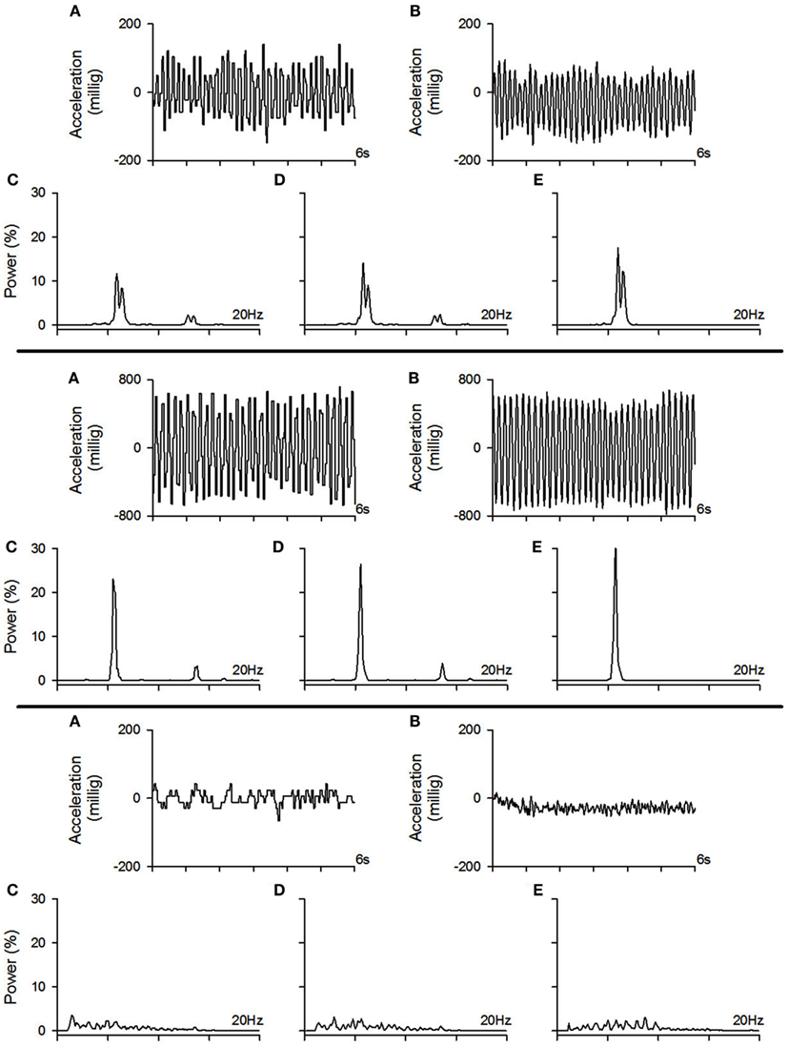
Device Connector
Simulated measurements
Mean frequency of the wrist (MeanFrequency)
Sensor: Wrist accelerometer from the smartwatch
Definition: MeanFrequency (Hz) is the mean frequency of the patient’s wrist acceleration in the window observation.
Critical value: MeanFrequency > 3 Hz

Slide 14
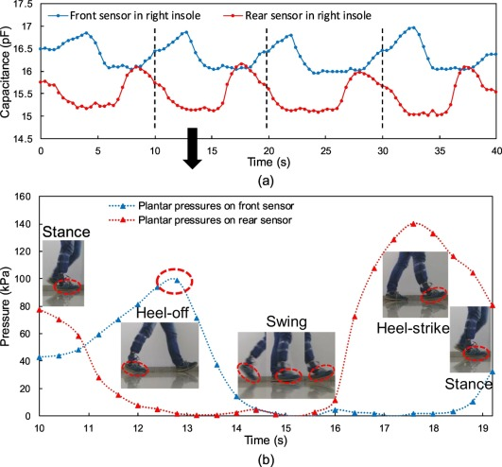
Device Connector
Simulated measurements
Pressure
Sensor: Pressure sensor in the sensorized insole
Definition: Pressure (kg) is the pressure exerted on the sensorized insole by the weight of the patient on both feet.
Critical value: Pressure < 30 Kg

Slide 15
Device Connector
Simulated actuators
Deep Brain Stimulation (DBS)
Device: Magnetic stimulator in the patient’s brain.
Sound Feedback (SF)
Device: Sound emitter in the smartwatch.
Activation: It is activated every time a tremor episode occur.
Activation: It is activated every time a freezing episode occur. This actuator will emit a 5 seconds rhytmic sound feedback. Hearing the rhythmic sound, the patient starts walking again.
Both actuators publish a MQTT message every 25 seconds to prove that they are active.

Slide 16
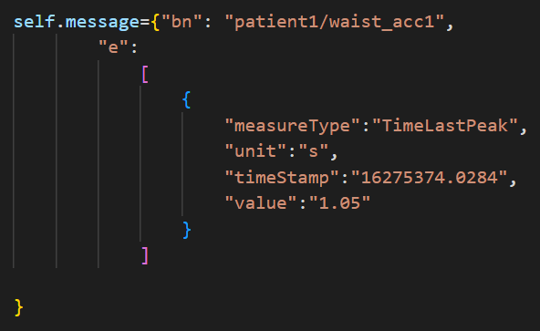
Device Connector
Communication with the system
REST Communication
MQTT Communication
The Device Connector communicates via REST Communication with the «Catalog_Manager».
Through this communication, the Device Connector can:
Register new patients;
Retrieve information of the desidered patients for the correct registration and publication of the respective measurements (ID, topics,…)
The Device Connector communicates via MQTT Communication with the Microservices.
Using the correct publish topic, the Device connector publish one message per sensor every 2 seconds, using SenML format.

Slide 17
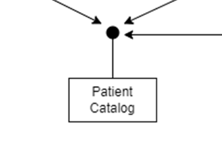
Catalog Manager

Slide 18



Catalog Manager
Catalog Manager
The Catalog Manager is responsible for the following tasks:
Providing information about «patient.json» to other actors via REST communications.
Managing the «patient.json» database, adding new patients, new devices and new services.
Updating the list of active devices into the «resource_catalog.json».

Slide 19
Providing informations
Catalog Manager
It provides information from «patient.json» catalog using REST communication. It is possible by using the retrieve functions (GET).
GET
Retrieve info about all the patients (IP/patient)
Retrieve info about one particular patient (IP/info/patientID)
Retrieve info about the MQTT settings (IP/broker)

Slide 20
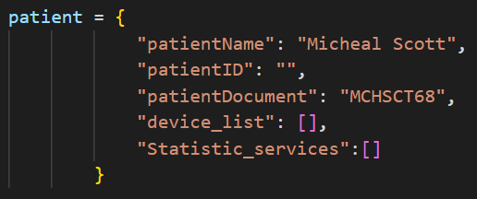
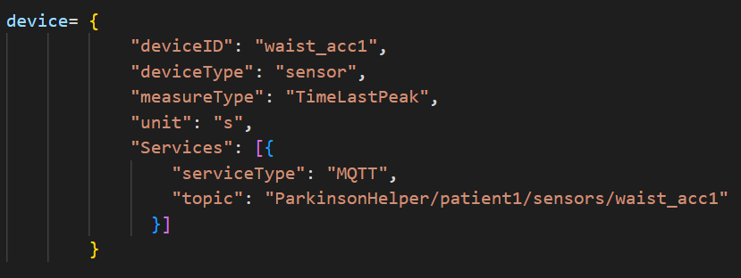
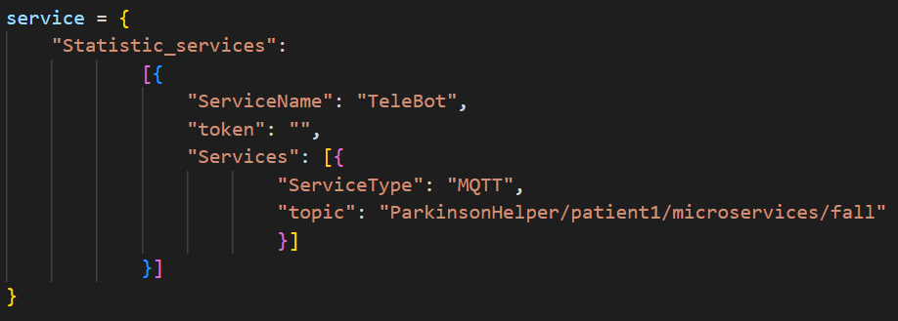
Managin «patient.json»
Catalog Manager
It manages the «patient.json» catalog using REST communication. It is possible by using the adding functions (POST).
POST
Adding patients (addp)
Adding devices (addd)
Adding services (adds)

Slide 21
Catalog Manager
Updating the active devices
It updates the «resource_catalog.json». It can add devices, update their last time update and delete non-active devices (if their last time update has not been updated in the last 30 seconds.)
Update
Adding devices
Updating their last time update
Deleting devices with time from last update > 30 s

Slide 22
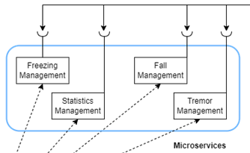
Microservices

Slide 23


Microservices
Microservices
The Microservices are responsible for the evaluation of the data and for the activation of the actuators in case of emergencies. There are four microservices:
Freezing management
Fall management
Tremor management
Statistics management

Slide 24
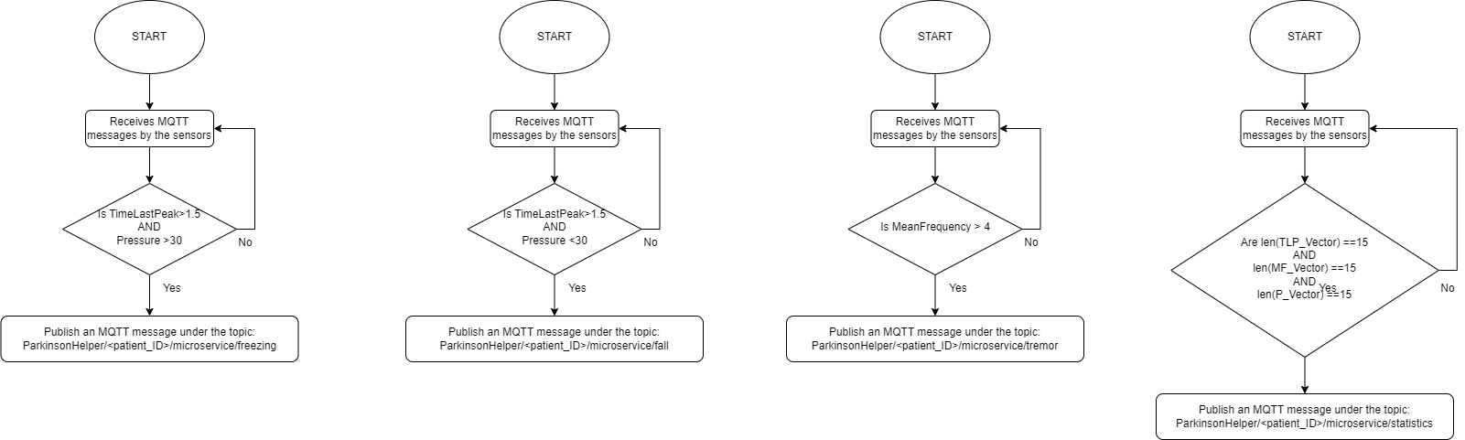
Microservices
Freezing management
The Freezing Management microservice is responsible for detecting a freezing episode.
It does occur when:
The patient stops walking (TimeLastPeak >1.5 on Waist accelerometer)
The patient is standing (Pressure >30)
When a freezing episodes occur, the microservice will publish a SenML message via MQTT. This will be received both by Thingspeak and the SoundFeedback actuator, which will be activated.

Slide 25
Microservices
Fall management
The Fall Management microservice is responsible for detecting a fall episode.
It does occur when:
The patient stops walking (TimeLastPeak >1.5 on Waist Accelerometer)
The patient is NOT standing (Pressure <30)
When a fall episodes occur, the microservice will publish a SenML message via MQTT. This will be received both by Thingspeak and Telegram Bot.

Slide 26
Microservices
Tremor management
The Tremor Management microservice is responsible for detecting a tremot episode.
It does occur when:
The patient is trembling violently (MeanFrequency >4 on Wrist Accelerometer)
When a tremor episodes occur, the microservice will publish a SenML message via MQTT. This will be received both by Thingspeak and the DBS actuator, which will be activated.

Slide 27
Microservices
Statistic management
The Statistic Management microservice is responsible for collecting all the sensors data and publish them via MQTT. This set of data will be collected by the ThingSpeak adaptor, which will post it on the personal page of the patient.

Slide 28
Microservice
Communication with the system
REST Communication
MQTT Communication
The Microservices communicates via REST Communication with the «Catalog_Manager».
Through this communication, the Microservices can retrieve information about the MQTT communication settings (broker and port).
The Microservices communicates via MQTT Communication with the Telegram Bot, the actuators, the sensors and the ThingSpeak adaptor.
Using the correct publish topic, the Microservices publish one message everytime a episode occur or everytime they collect enough data, using SenML format.

Slide 29
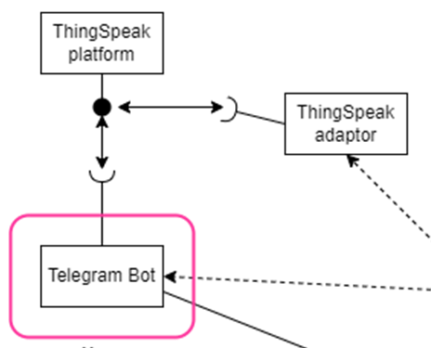
User awareness - Telegram Bot

Slide 30




Telegram Bot
Telegram Bot
Telegram is a well know instant-messaging service and it provides the possibility to create Bots, Telegram accounts operated by programs.
In our system, a Telegram Bot called ParkinsonPal has been created for:
Helping the patient and the doctor to monitor the situation in a quick and easy way.
Notify the caregivers if a fall episode occurred.

Slide 31




Telegram bot
Functionalities description
The TeleBot ParkinsonPal has 4 main functions:
Start
· Registration. Registration with the Patient ID
· Selection of further functionalities. It is possible to select to display the Doctor or Patient interface, or the format of the statistics.
Statistics
· Recorded statistics from the specified patient. Data such us the number of falls, the number of tremor episodes, etc.
Help Command
· Help window. Shows the complete list of commands and their descriptions
Emergency management
· Emergency messages. The telegram bot shows Emergency messages asyncronously when a full episode is detected

Slide 32

Telegram Bot
Patient side of TeleBot
Login with patient*
Choose with info retrieve between:
Actual measures
Daily episodes
Receive important notification about each event.

Slide 33

Telegram Bot
Doctor side of TeleBot
See the list of patients, with name, surname and ID
Insert the desired patientID
Choose which info retrieve between:
Patient info
Actual measures
Daily episodes.

Slide 34
ThingSpeak
Communication with the system
REST Communication
MQTT Communication
Telegram bot retrieves information about the correct MQTT topics by REST communication.
The telegram bot communicates via MQTT Communication with the Microservices.
When the Telegram bot is able to report fall episodes asyncronously by subscribing to the fall topic, and, it can show the last statistic measurements subscribing to the statistics topic.

Slide 35
User awareness - ThingSpeak

Slide 36




ThingSpeak
ThingSpeak
ThingSpeak is a platform used as database, in which all the measurements are stored.
In particular, in this system ThingSpeak is used to:
Store sensor data;
Store the number of adverse events or emergencies;
Create statistical evaluation of each sensor measurement.
ThingSpeak also offers the possibility to create a webpage for each patient, in which they can see different grafs to monitor their situations.

Slide 37
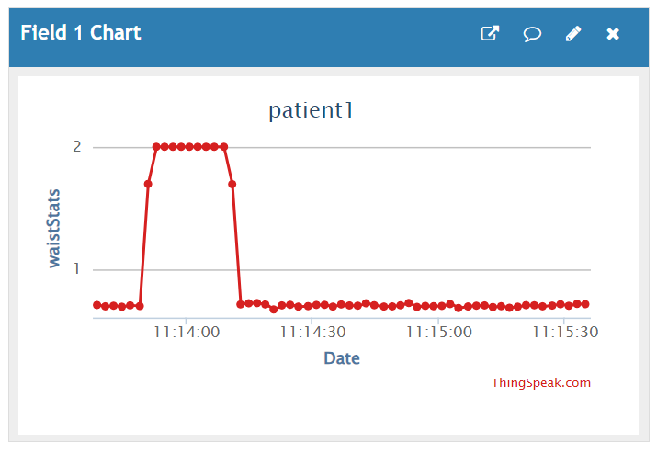
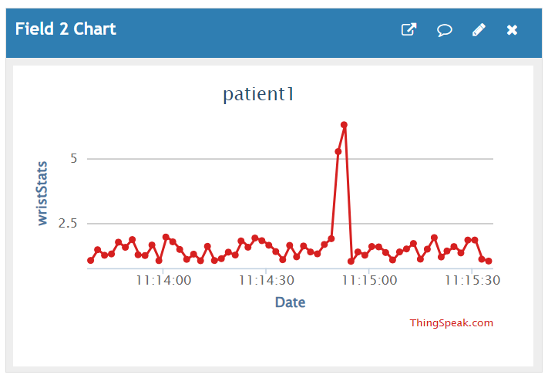
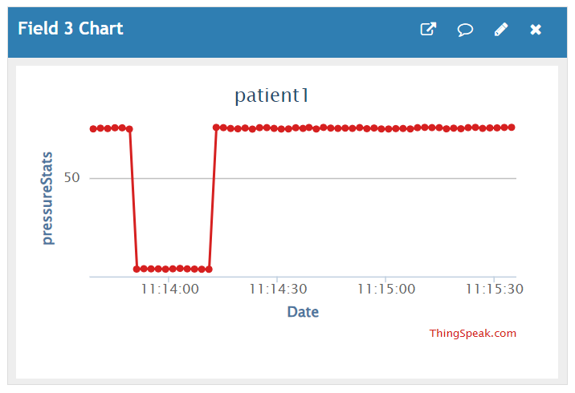
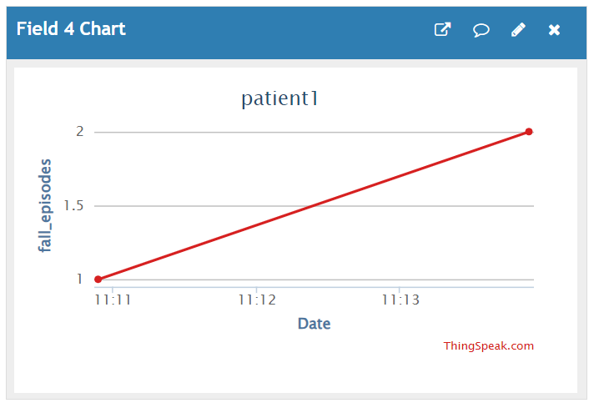
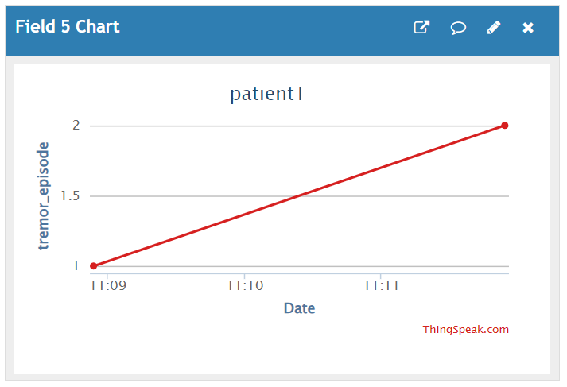
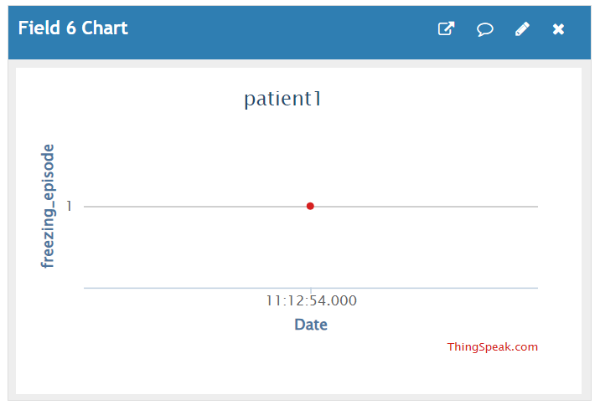
ThingSpeak
Thingspeak Graphic User Interface
Measures graphs
Episodes graphs

Slide 38
ThingSpeak
Communication with the system
REST Communication
MQTT Communication
Thingspeak adaptor will retrieve information about the correct MQTT topics by REST communication.
ThingSpeak communicates via MQTT Communication with the Microservices.
When ThingSpeak receives a message, it checks the content of the message and proceeds to append the measurements into the corresponding graph, for the correct patient.
It does receives both the measurements from the «Statistic Management» and the trigger messages from «Tremor Management», «Fall Management» and «Freezing Management».

Slide 39


Future improvements
Introducing a more «user friendly» system to register new patient.
Insert other info to retrieve (e.g. episodes in a specific range of time)
Introducing a solution for managing depression
Weekly questionnaires
Emergency number

Slide 40

Thank you for the attention!

